Slide 1

INTRODUCTION TO SUSTAINABILITY
SUSTAINABILITY CONCEPTS
This Photo by Unknown author is licensed under CC BY-SA.

Slide 2

"The operationalization of sustainability is even tougher than defining sustainability "
This Photo by Unknown author is licensed under CC BY-SA.

Slide 3
IMPORTANCE OF SUSTAINABILITY INDICATORS
Better decision-making - lowering risks or costs​
Identification of emerging issues - allowing prevention​
Identification of impacts - allowing corrective action when needed​
Performance measurement of the implementation of plans and management activities – evaluating progress in overall sustainable development​
Reduced risk of planning mistakes - identifying limits and opportunities​

Slide 4

TRIPLE BOTTOM LINE (TBL)
The TBL is a planning and reporting system and decision-making framework that focuses on measuring and controlling companies’ economic, environmental and social performance
The TBL encompasses the 3 dimensions of environmental, social, and economic dimensions which are commonly referred to as the 3P’s: Planet, People and Profits as well
The TBL was initially developed as a framework for measuring and reporting corporate performance beyond the single Bottom of economic profitability by adding the dimensions of environmental and socio-cultural bottom lines into the equation. However, over the years the overall agenda of the TBL concept has evolved into a wider planning mechanism (Mihalič, et al., 2012)
This Photo by Unknown author is licensed under CC BY-SA-NC.

Slide 5
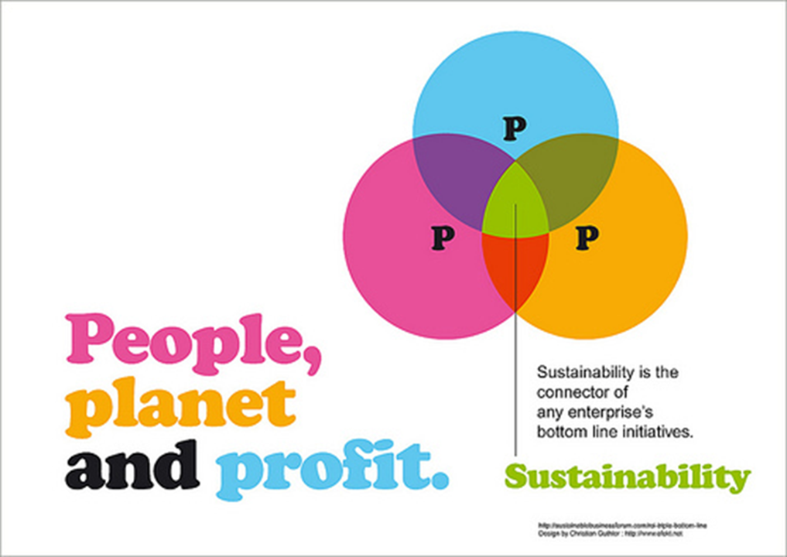

Slide 6
ASSUME THAT YOU ARE AN OWNER/ SENIOR MANAGER OF YOUR OWN BUSINESS/ REPUTED COMPANY IN SRI LANKA. RATE THE LEVEL OF IMPORTANCE AND FOCUS THAT YOU WILL BE PUTTING FORWARD FOR EACH PILLAR OF THE TRIPLE BOTTOM LINE USING THE BELOW LINK:

Slide 7
NAME SOME ENVIRONMENTAL SUSTAINABILITY INITIATIVES

Slide 8
ENVIRONMENTALLY SUSTAINABLE PRACTICES
Use of renewable energy
Water Conservation
Electricity conservation
Waste Management
Air quality management
Elimination/ Reduction of plastic usage
Green purchasing
Environmentally friendly housekeeping
Sustainable transportation options
Sustainable recreation options
Environmental education
Protection and preservation of biodiversity

Slide 9
NAME SOME SOCIAL SUSTAINABILITY INITIATIVES

Slide 10
SOCIALLY SUSTAINABLE PRACTICES
Diversity and equality of opportunity at workplace
Staff training and development
Health and safety of employees
Cultural heritage preservation
Community commitment
Charitable giving
Volunteerism
Charity events
Local event sponsorship

Slide 11
ECONOMICALLY SUSTAINABLE PRACTICES
Profit & Revenue growth
Market growth
Market capitalization
Fair trade
Legal compliance

Slide 12
LIMITATIONS OF TBL APPROACH
The first limitation of the TBL approach revolves around social measurement. Some sectors and industries are unique, and social performance can only be understood if a certain level of alignment to the issues and problems present in that industry context is mapped out
The second limitation found in the TBL approach is a lack of ability to aggregate the results across the three principles of TBL. Firstly, TBL offers no means of prioritizing among the requirements of different stakeholder groups. Secondly, it provides no method or formula in its framework that can aggregate across the TBL principles
The third limitation found in the TBL approach is the lack of integration. Firstly, the integration between the three dimensions of TBL will be hard as people are trained to be experts in each of the three dimensions and not across all of them (Sridhar & Jones, 2013)

Slide 13
CORPORATE SOCIAL RESPONSIBILITY (CSR)
CSR is concerned with treating the stakeholders of the firm ethically or in a responsible manner. ‘Ethically or responsible’ means treating stakeholders in a manner deemed acceptable in civilized societies. Social includes economic responsibility. Stakeholders exist both within a firm and outside. The natural environment is a stakeholder. The wider aim of social responsibility is to create higher standards of living, while preserving the profitability of the corporation, for peoples both within and outside the corporation

Slide 14
UNDERSTANDING BUSINESS PRIORITIES

Slide 15
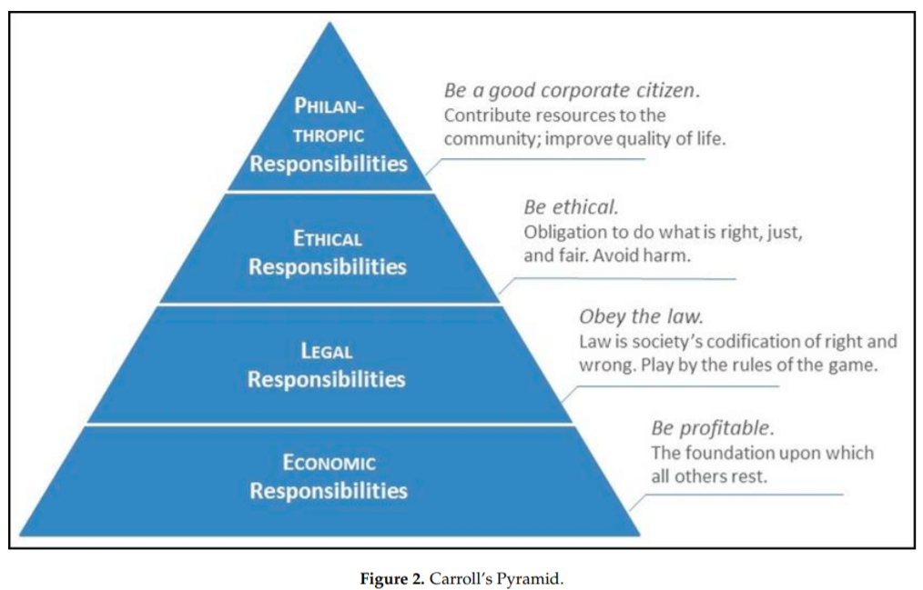
Carroll proposed dividing CSR into four tiers of responsibilities which were ordered according to priority from bottom to top for socially responsible behaviour or activity. His categories of activity ascended from the foundations of economic obligation, to legal, through ethical to philanthropic obligations at the apex. Basically, Carroll argued that a firm has to be financially viable as a first responsibility or it could not exist at all and make no further contribution.

Slide 16
SUSTAINABILITY VS CSR
SUSTAINABILITY
CORPORATE SOCIAL RESPONSIBILITY
Economic, social, and environmental pillars are interconnected
Social, environmental, and economic responsibilities are complementary—the three elements must be integrated to achieve perfection
Targets the whole value chain and a broad stakeholder base
Treats social and economic performance as independent components
Supplements the primary fundamental responsibility of businesses—economic prosperity
Tends to target opinion formers – Stakeholders that play a role in the business

Slide 17
STAKEHOLDER THEORY
Stakeholder theory is basically about how a business works at its best, and how it could work. It is about value creation and how to manage a business effectively.
Stakeholder theory identifies a set of relationships between customers, suppliers, communities, employees, shareholders or any other party that has an active interest on a given business

Slide 18
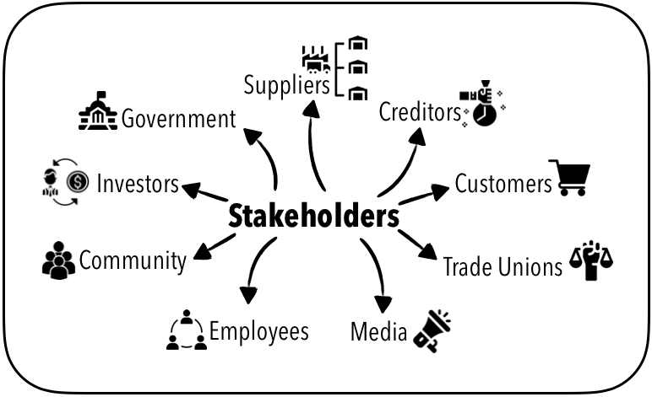

Slide 19
ROLE OF STAKEHOLDERS IN ACHIEVING SUSTAINABILITY

Slide 20
STAKEHOLDER THEORY IN SUSTAINABILITY CONTEXT
Stakeholder theory expands the scope to a broader societal embeddedness of organizations and its interdependencies with the societal environment
Similarly, corporate sustainability emphasize the interdependencies between the organization and its societal and natural environment
Both concepts extend the view beyond maximizing short-term shareholder value or accounting-based profits and share a broader understanding of the embeddedness, dependencies, obligations, abilities, and possibilities of companies

Slide 21

CIRCULAR ECONOMY
Circular economy can be defined as a regenerative system in which resource input and waste, emission, and energy leakage are minimised by slowing, closing, and narrowing material and energy loops. This can be achieved through long-lasting design, maintenance, repair, reuse, remanufacturing, refurbishing, and recycling
The core of the Circular Economy is the circular (closed) flow of materials and the use of raw materials and energy through multiple phases
Circular economy is also refered to as a 'loop economy'
This Photo by Unknown author is licensed under CC BY-NC.

Slide 22
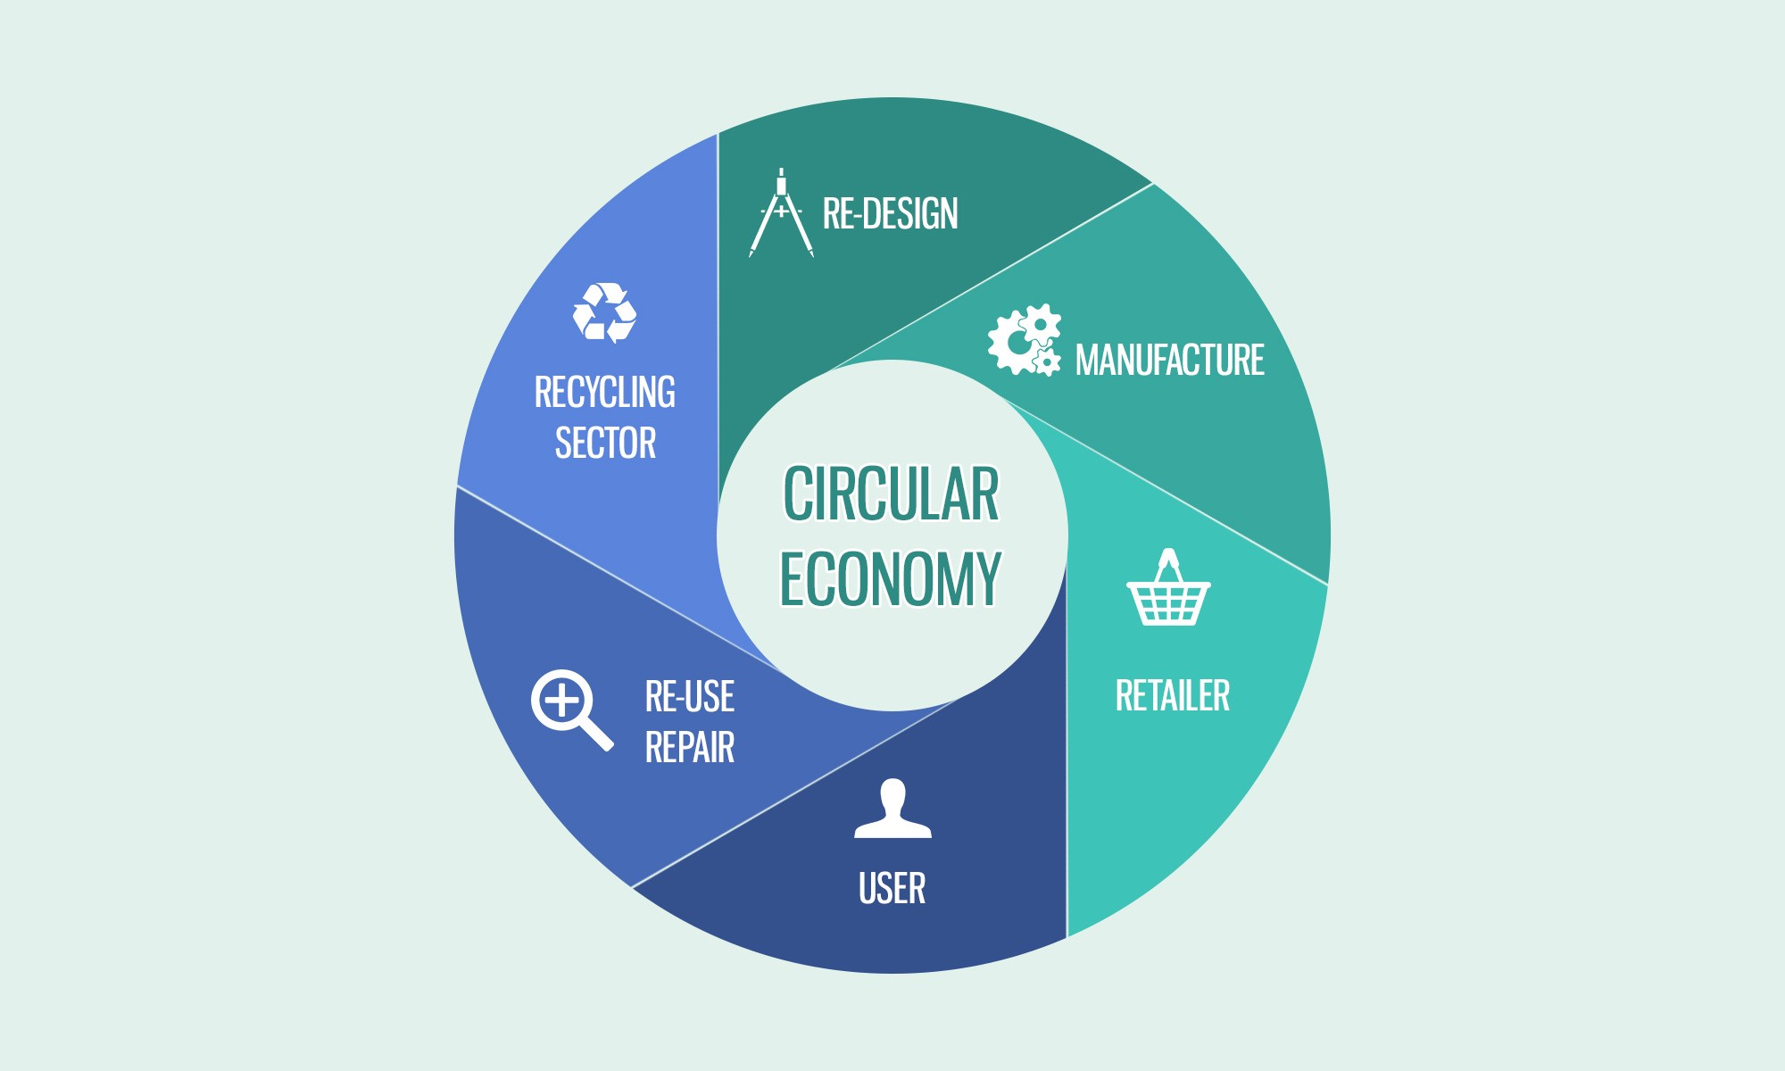

Slide 23
CIRCULAR ECONOMY
The circular economy is a new and inclusive economic paradigm, that aims to minimize pollution and waste, extend product lifecycles and enable broad sharing of physical and natural assets.
A circular economy aims to design out waste. Waste does not exist: products are designed and optimized for a cycle of disassembly and reuse
The circular economy doesn’t aim to end growth; it aims to bend how we do things back into harmony with nature, so that growth can continue. It aims at achieving prosperity in a world of finite resources.

Slide 24
SUSTAINABILITY & CIRCULAR ECONOMY
SUSTAINABILITY
CIRCULAR ECONOMY
Priorotizes on the Triple Bottom Line
Aims to benefit 3P's/ TBL
Open ended, varies with stakeholders
Tries to 'sustain' the current status indefinitely
Priorotizes on the economy
Aims to benefit economy & environment
Closed loop. Aim is to prevent any leakages from the system
Consists of input and leakage thresholds

Slide 25
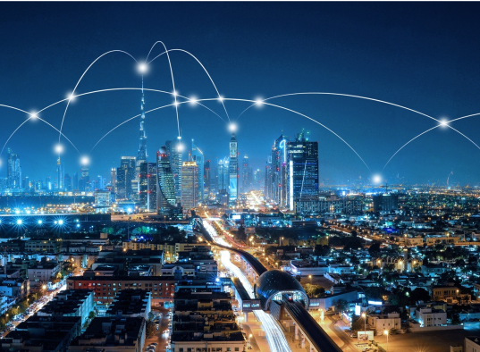
SMART ECONOMY
Smart Economy is defined as the main base of urban development in a smart community. This model is based on a series of concepts to promote development and achieve sustainability. The main areas of consideration in a Smart Economy are: e-business, e-commerce, increase of productivity, innovation and new product development.
The hall mark of a smart economy is smart cities. A smart city refers to any city that uses ICT to improve operational efficiency, information sharing with the public and provide a better quality of service and welfare. The value lies in how this technology is used rather than simply how much technology is available.
This Photo by Unknown author is licensed under CC BY-NC-ND.

Slide 26
SMART ECONOMY – FOCUS AREAS
Entrepreneurship, Productivity & Competitiveness: urban organization that fosters new entrepreneurial initiatives, an increase of competitiveness and high productivity in communities with the aim of improving the quality of life
Research and Development : offer solutions which can be adopted by other cities, and thus obtain a return on investment through the creation of innovative services
Tourism promotion and Internationalization: Allowing the city to go international and attract prospective tourists
Training: training of the community, their personal development and the fostering their creative ability.

Slide 27
SMART CITY – FOCUS AREAS
An infrastructure based around technology
Environmental initiatives
Effective and highly functional public transportation
Confident and progressive city plans
People able to live and work within the city, using its resources

Slide 28
